Slide 1



2025
LINCOLN TEEN READERS’ CHALLENGE

Slide 2
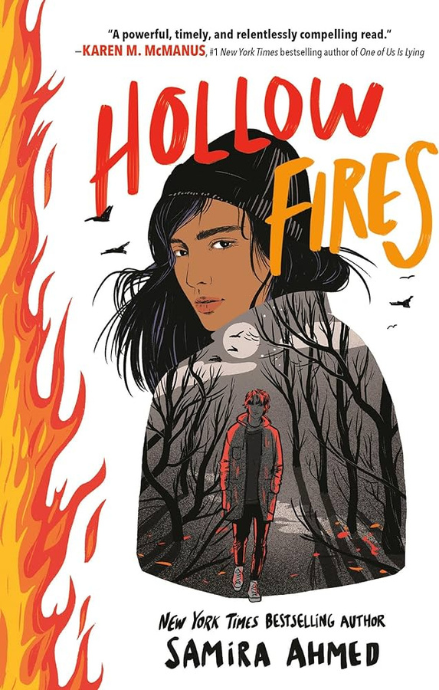
HOLLOW FIRES
BY SAMIRA AHMEND
After discovering the body of fourteen-year-old Jawad Ali in Jackson Park, seventeen-year-old journalism student Safiya Mirza begins investigating his murder and ends up confronting white supremacy in her own high school.
CLICK HERE for an audiobook excerpt.

Slide 3

I’M GLAD MY MOM DIED
BY JENNETTE MCCURDY
A memoir by iCarly and Sam & Cat star Jennette McCurdy about her struggles as a former child actor including eating disorders, addiction, and a complicated relationship with her overbearing mother and how she retook control of her life.
CLICK HERE FOR AN AUDIOBOOK EXCERPT

Slide 4
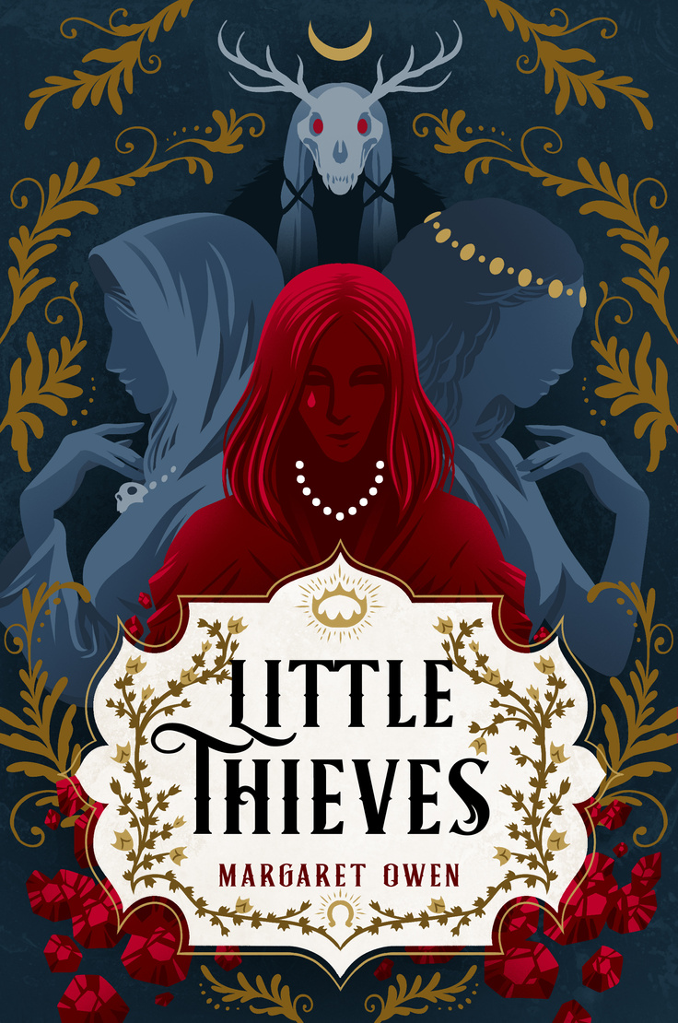
LITTLE THIEVES
BY MARGARET OWEN
Posing as a royal to rob the nobles blind, seventeen-year-old Vanja Schmidt is thrilled by her luck until she crosses the wrong god and is cursed to turn into the jewels she covets unless she can pay back her debts quickly.
CLICK HERE for the book trailer

Slide 5

LOVE IN ENGLISH
BY MARIA E. ANDREU
Feeling blocked after moving from Argentina to New Jersey, a sixteen-year-old poet finds herself torn between a cute American boy in her math class and a Greek student who understands the struggles she is facing in an ESL class.
CLICK HERE for the book talk

Slide 6
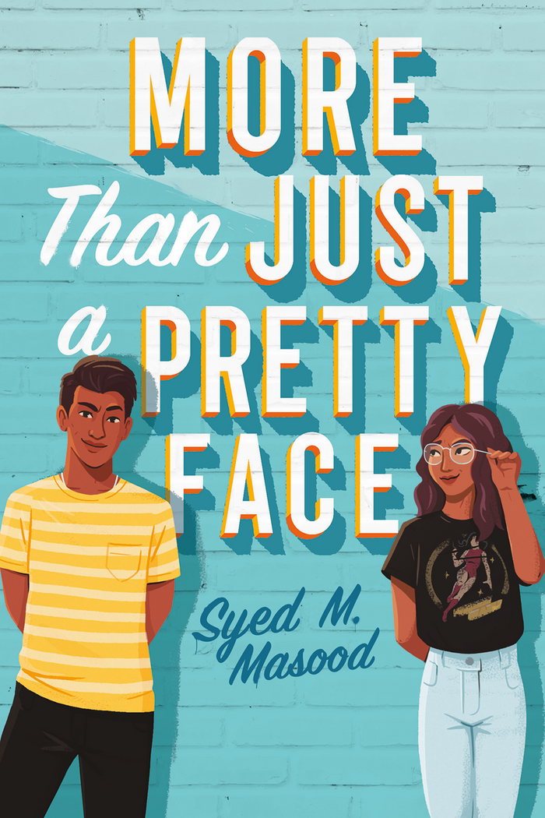
MORE THAN JUST A PRETTY FACE
BY SYED M. MASOOD
When self-proclaimed “not very bright” nineteen-year-old Danyal is chosen for a prestigious academic contest, he hopes to impress a potential arranged marriage match, only to begin falling for the girl helping him study instead.
CLICK HERE for the Audiobook excerpt

Slide 7
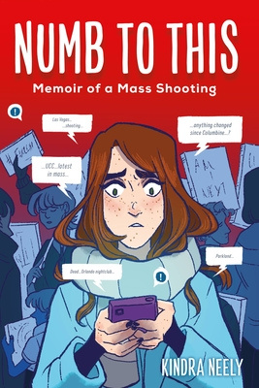
NUMB TO THIS
BY KINDRA NEELY
Author Kindra Neely recounts her journey to healing after surviving a mass shooting during her first year of college.
CLICK HERE for an interview with the author

Slide 8
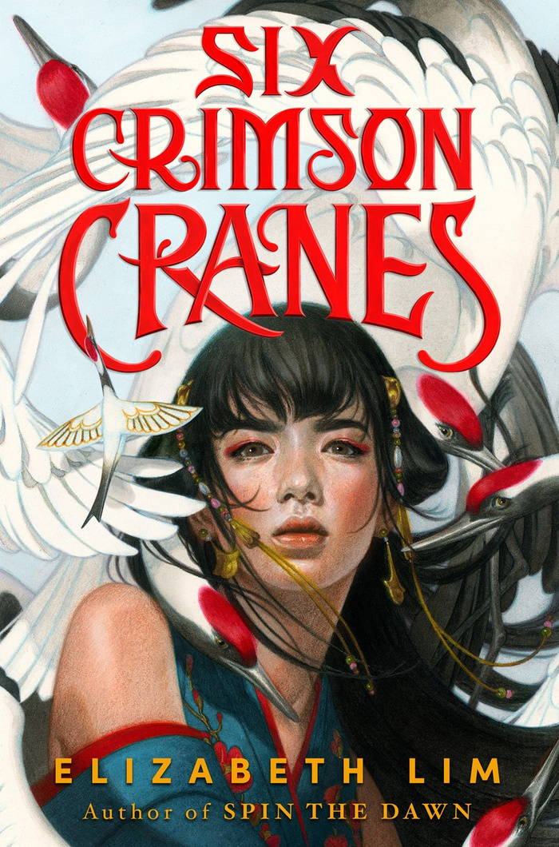
SIX CRIMSON CRANES
BY ELIZABETH LIM
The exiled Princess Shiori must unravel the curse that turned her six brothers into cranes, and she is assisted by her spurned betrothed, a capricious dragon, and a paper bird brought to life by her own magic.
CLICK HERE for the Audiobook excerpt

Slide 9

SKYHUNTER
BY MARIE LU
Talin is a Striker, a member of an elite fighting force that stands as the last defense for Mara, the only free nation in the world, but when a mysterious prisoner is brought from the front to Mara's capital, Talin senses there is more to him than meets the eye.
CLICK HERE for an author introduction

Slide 10
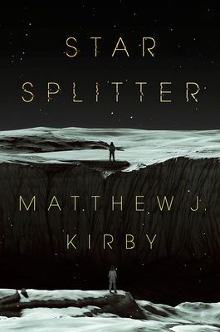
STAR SPLITTER
BY MATTHEW J. KIRBY
In 2199, 17-year-old Jessica Mathers wakes up on a desolate, post-extinction planet 14 light years from Earth and must make sense of the bloody destruction around her, as well as the questionable intentions of a familiar stranger.
CLICK HERE for an audiobook excerpt

Slide 11
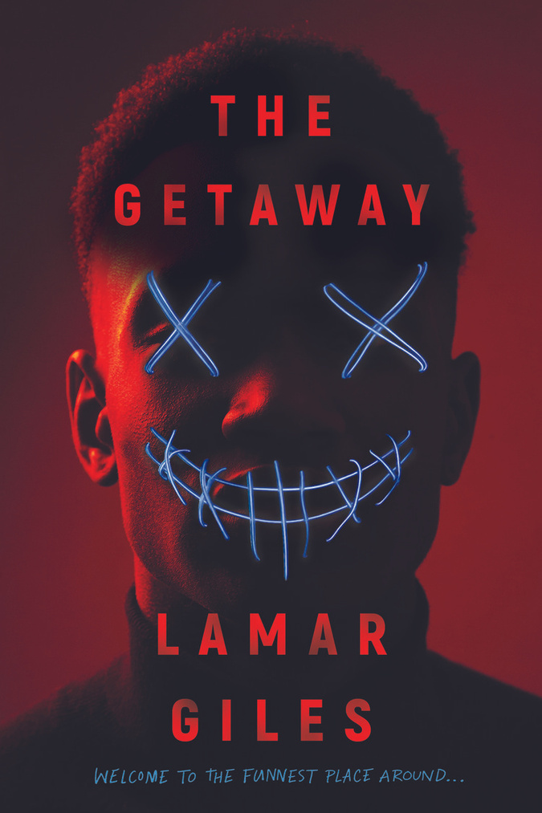
THE GETAWAY
BY LAMAR GILES
Jay discovers that mountain resort where he lives and works with his friends and family is also a doomsday oasis for the rich and powerful who expect top-notch customer service even as the world outside the resort's walls disintegrates.
CLICK HERE for the book trailer

Slide 12
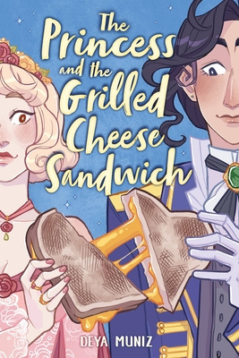
THE PRICESS AND THE GRILLED CHEESE SANDWICH
BY ELIZA MUNIZ
Cam disguises herself as a man to inherit her father's money and estate, and though she tries to keep a low profile, she ends up falling for Crown Princess Brie.
CLICK HERE for the book talk and trailer

Slide 13

THIS GOLDEN STATE
BY MARIT WEISENBERG
Seventeen-year-old Poppy takes a home DNA test and unravels her parents' identities and their decades of careful work to keep their family anonymous, allowing the past to come dangerously close to catching up to them.
CLICK HERE for the audiobook excerpt

Slide 14

VICTORY STAND: RAISING MY FIST FOR JUSTICE
BY TOMMY SMITH
A groundbreaking and timely graphic memoir from one of the most iconic figures in American sports-and a tribute to his fight for civil rights.
CLICK HERE for the Video book Reading

Slide 15

WE ARE ALL SO GOOD
AT SMILING
BY AMBER MCBRIDE
When hospitalized for her clinical depression, Whimsy connects with a boy named Faerry, who also suffers from the traumatic loss of a sibling, and together they work to unearth buried memories and battle the fantastical physical embodiment of their depression.
CLICK HERE for the meet-the-author recording

Slide 16

WE DESERVE MONUMENTS
BY JAS HAMMONDS
When seventeen-year-old Avery moves to rural Georgia to live with her ailing grandmother, she encounters decade-old family secrets and a mystery surrounding the town's racist past.
CLICK HERE for the audiobook trailer

Slide 17
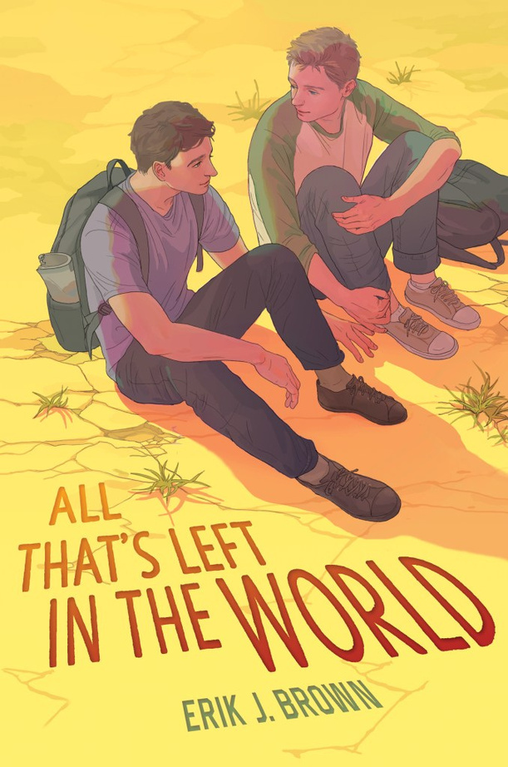
ALL THAT’S LEFT IN
THE WORLD
BY ERIK J. BROWN
Putting their trust in one another, two boys, Andrew and Jamie, search for civilization in a world ravaged by a deadly pathogen, but their secrets could cost them everything as they try to find the courage to fight for the future, together.
CLICK HERE for the book Talk

Slide 18

BELLADONNA
BY ADALYN GRACE
Nineteen-year-old orphan Signa Farrow confronts Death and her own deathly powers when she investigates the mysterious murder of a relative at the Thorn Grove estate.
CLICK HERE for the book Talk

Slide 19
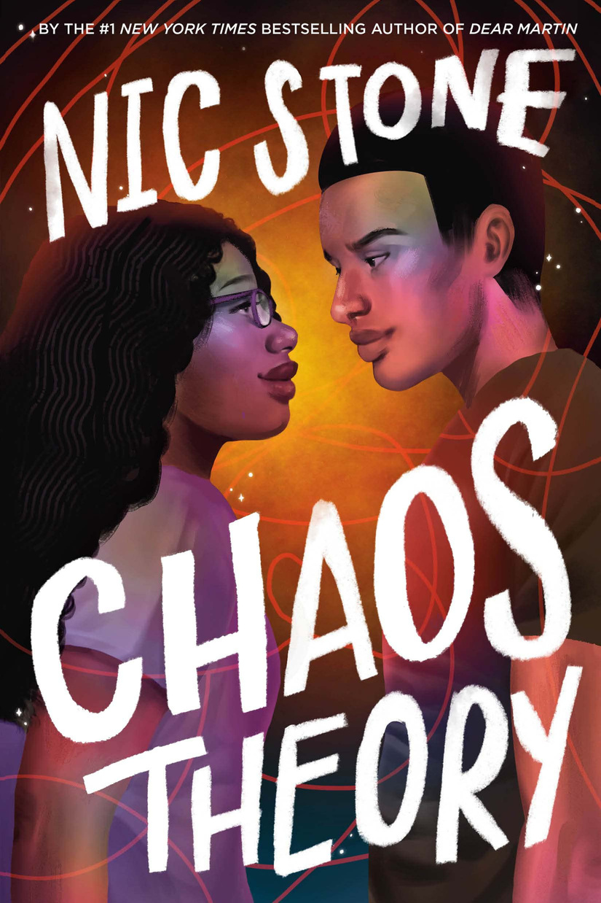
CHAOS THEORY
BY NIC STONE
A senior at Windward Academy, Shelbi, who has a diagnosed mental illness, keeps to herself until she forms a connection with Andy Criddle, who is battling addiction, but the closer they get, the more the past threatens to pull them apart.
CLICK HERE for the book Trailer

Slide 20
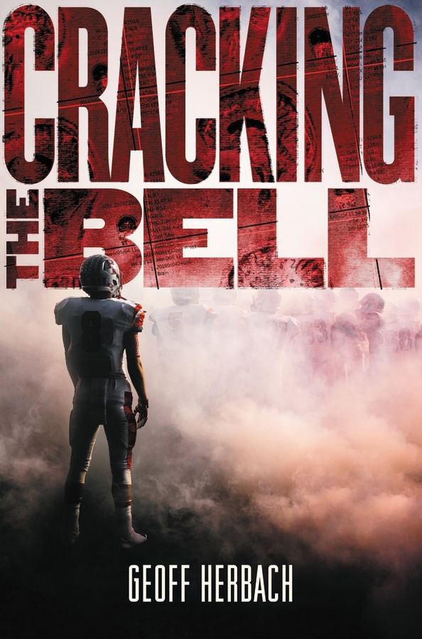
CRACKING THE BELL
BY GEOFF HERBACH
Isaiah loves football. In fact, football saved Isaiah's life, giving him structure and discipline after his sister's death tore his family apart. But when Isaiah gets knocked out cold on the field, he learns there's a lot more to lose than football.
CLICK HERE for the book Talk

Slide 21
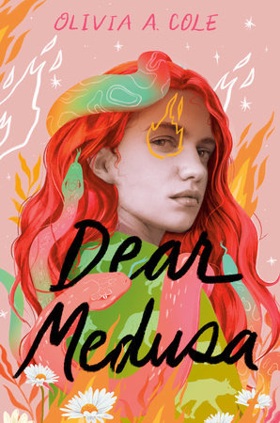
DEAR MEDUSA
BY OLIVIA A. COLE
Sixteen-year-old Alicia, who feels isolated and alone after being sexually abused by a teacher, is casts as the slut who asked for it, until she receives mysterious letters hinting at another victim, forcing her to face her trauma and fight back.
CLICK HERE for the book Talk

